Slide 1
Midterm Report
Drew Massey
Dale Bromenshenkel
Brad Hoffman

Slide 2
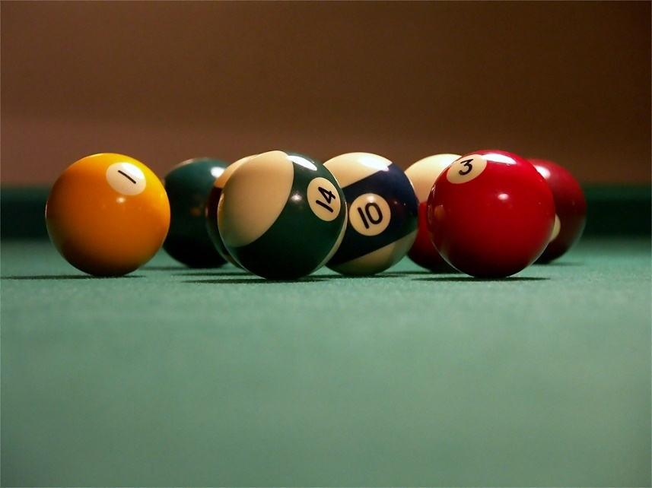
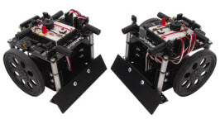
Main Objective
Create a system which can take in camera input, process the image, and use the data to drive a robot.

Slide 3

Current Setup
Github Code Repository
Prototype area
Little Robot
SimpleCV Python Modules

Slide 4

SImpleCV
Simple Computer Vision
Python Module
Dependencies: OpenCV, Pygame, Scipy, Numpy, SvgWrite
Ball Track
Tracks a ball around the screen

Slide 5
Robot

Slide 6


Future Tasks
Integrate code into Jenkins
Allow continuous integration of code
Scale up design area
Build a bigger testing area
Give robot more abilities
Interact more with environment
Integrate SimpleCV into Blender for realtime 3D data.

